Slide 1
DEEP LEARNING IN COMPUTER VISION
DR. AHMAD AL SALLAB,
Valeo Deep Learning Senior Expert

Slide 2
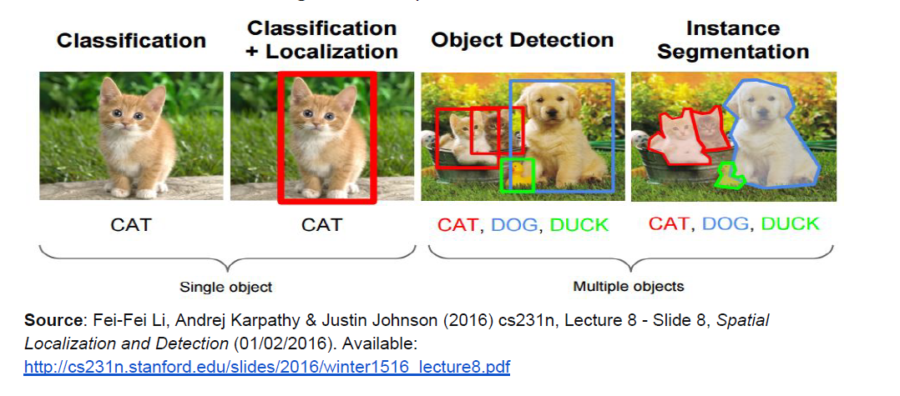
What do we want from computer vision?
Analysis (understanding) or Synthesis
And many others

Slide 3
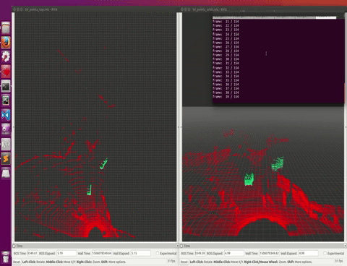

Camera or any sensor, 2D or 3D

Slide 4
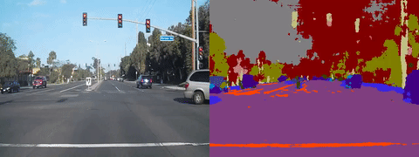
What computers can see today?

Slide 5
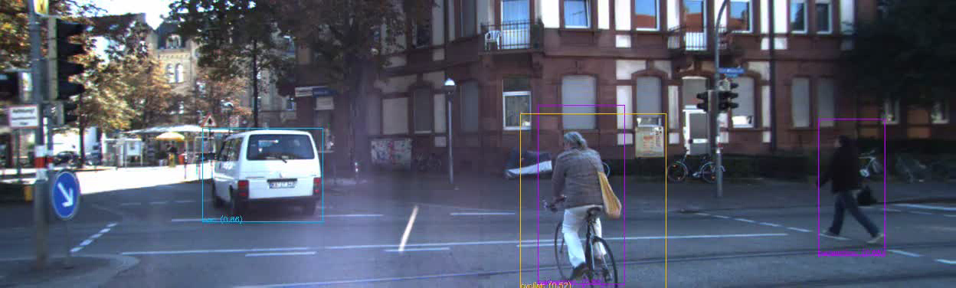
What computers can see today?

Slide 6

WELCOME
Ahmad EL-SALLAB
Ph.D. Cairo University, 2010-2014
M.Sc., Cairo University, 2007-2009
Publications and research
18+ publications in ML/DL, Speech, Comp Vision, Robotics, NLP
Research gate profile: Ahmad A. Al Sallab
Valeo, 2008-Now
Senior Expert of AI, Valeo Goup
Senior Chief, Cairo AI Research Team
Intel, 2005-2008
Lecturer at Cairo University and Information Tech. Institute (ITI)

Slide 7
AGENDA
Part 1: From traditional computer vision to Deep Learning
Part 2: 2D Deep Learning for computer vision
Part 3: 3D Deep Learning for computer vision

Slide 8
AGENDA
Part 1: From traditional computer vision to Deep Learning

Slide 9
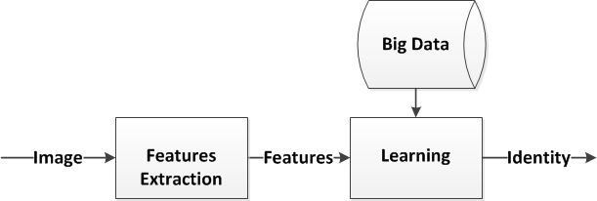
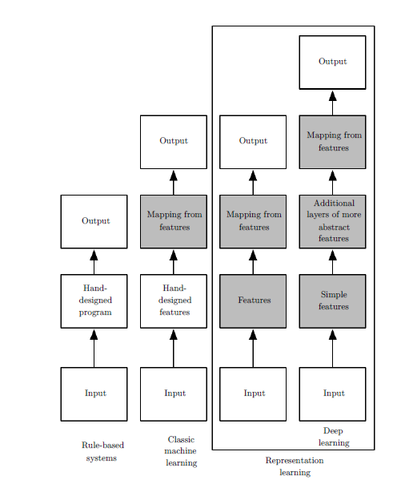
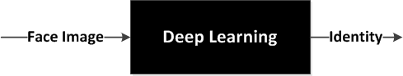
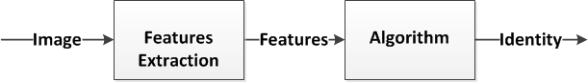
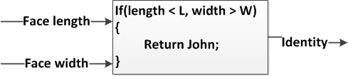
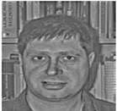
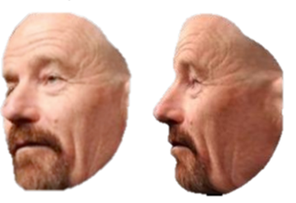
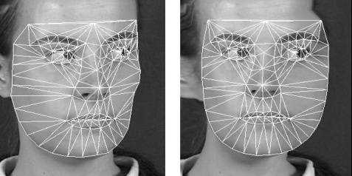
TRADITIONAL COMPUTER VISION PIPELINE

Slide 10
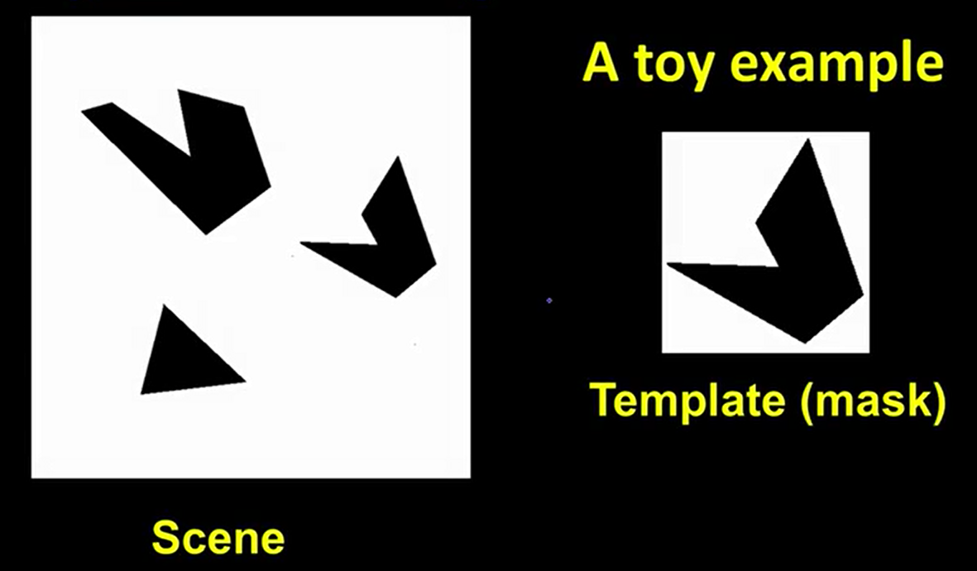
COMMON FEATURES IN COMP VISION
Filters as template matching

Slide 11
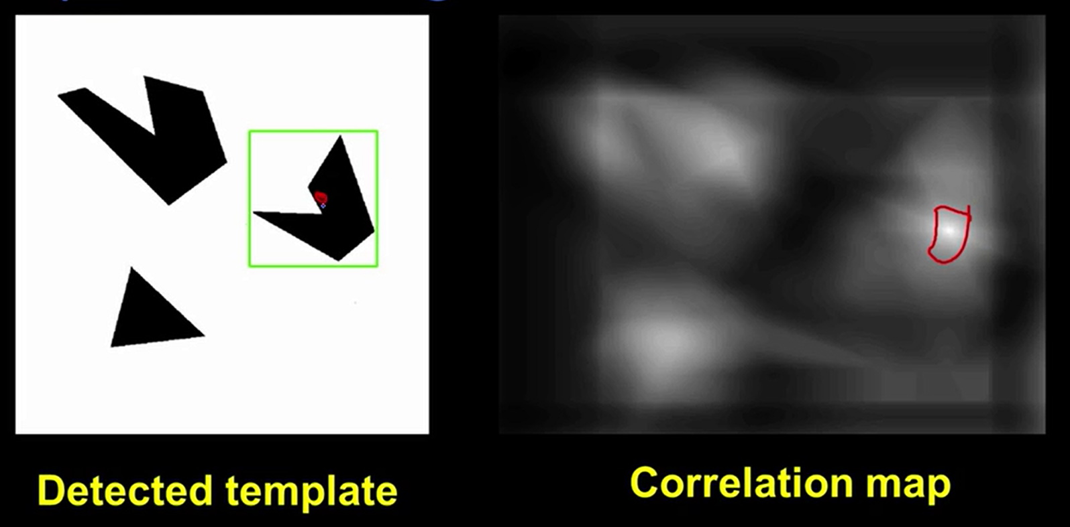
FILTERS AS TEMPLATE MATCHING
Extraction = matching 🡪 Applying a feature kernel (template) to an image results in a feature map

Slide 12
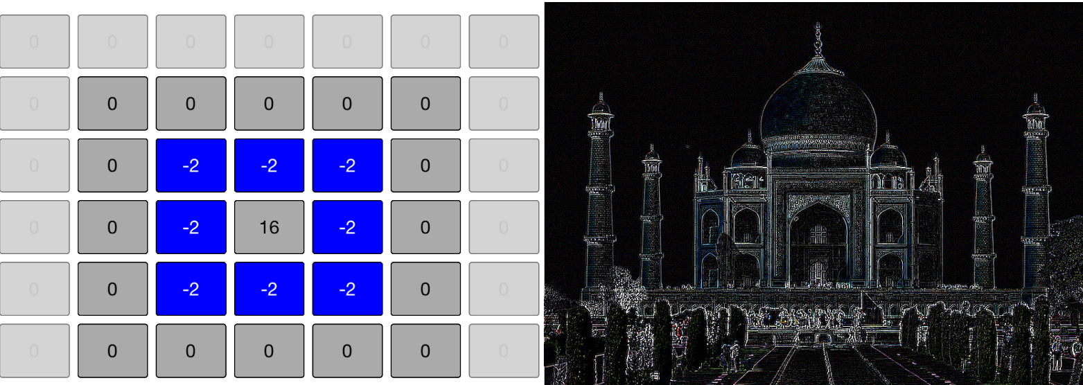
POPULAR FEATURES – EDGE DETECTORES
Feature = template
Extraction = matching
Example of features are edge detectors
A Kernel is a feature detector – Local features

Slide 13
HOW TO DECIDE ON THE KERNEL WEIGHTS?
Kernel weights = features
Method 1 = Hand crafted 🡪 like vertical or horizontal edges
Method 2 = Learning! 🡪 ConvNets
Why learn the weights not hand craft them?
Because you cannot encode all cases!
Pose, rotation, illumination,…etc.
Leave it to data to guide the algorithm

Slide 14
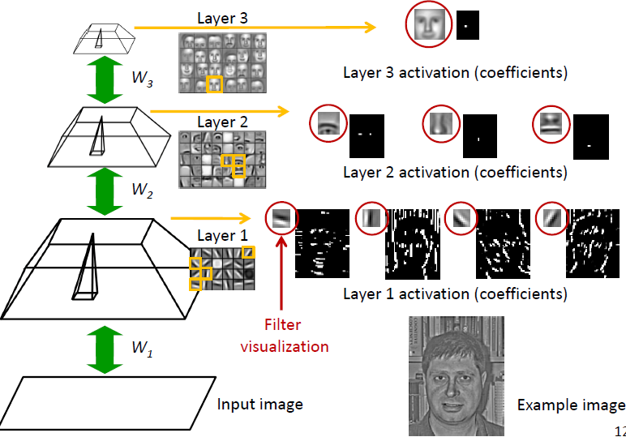
WHY LAYERS OF CONVOLUTIONS? ABSTRACTION
Deep learning summer school, Montreal, 2015: Convolutional NN, Lee
Notes:
Convolution works better for computer vision tasks:
1- They exploit the spatial locality
2- They reduce the size of the network. As we said, the 1st layer must be overcomplete, i.e. >> input. With convolution, the max-pooling reduces this size
The fitting of weights is the same as before, except contrastive divergence runs on the conv. Area only.

Slide 15
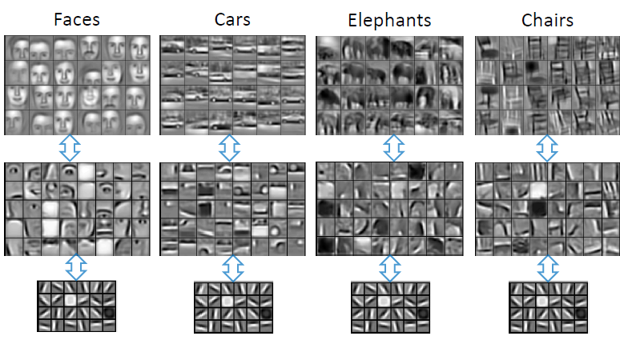
COMMON FEATURES DETECTOR (SHARED TASK LEARNING)

Slide 16

WHY NOW?
Algorithms
Learn from
Use
Big Data
Powerful
Hardware
Process

Slide 17
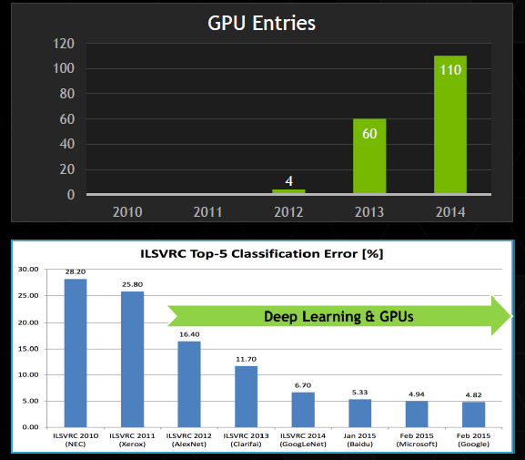
COMPUTING POWER
Real breakthrough with AlexNet on GPU in 2012

Slide 18
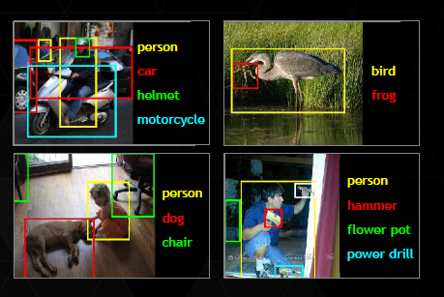
DATASETS
ImageNet Challenge
Each year entrants compete in a series of different tasks called the ImageNet Large Scale Visual Recognition Challenge (ILSVRC).
Available: http://image-net.org/challenges/LSVRC/2016/index
1000 objects categories
1.2M images
If correct guess is in the top 5 guesses it’s counted OK

Slide 19
DATASETS
Others:
CIFAR
MNIST
Cityscapes
KITTI
…etc
COCOO
PASCAL VOC

Slide 20
RECENT RESULTS (2016)
ImageNet LSVRC Object Detection from Images (DET): CUImage 66%
meanAP. Won 109 out of 200 object categories.
● ImageNet LSVRC Object Detection from video (VID): NUIST 80.8% mean AP
● ImageNet LSVRC Object Detection from video with tracking: CUvideo 55.8%
mean AP
● COCO 2016 Detection Challenge (bounding boxes): G-RMI (Google) 41.5%
AP (4.2% absolute percentage increase from 2015 winner MSRAVC)

Slide 21
AGENDA
Part 2: 2D Deep Learning for computer vision

Slide 22
Master Architectures: RECURRING THEME
Segmentation: Encoder-Decoder
Classification: Encoder + Softmax
Detection: Encoder + (Decoder1 = Classifier, Decoder 2 = Group of Regressors)

Slide 23
META-ARCHITECTURES AND PRE-TRAINED NETS
Beside the Vanilla ConvNet architecture, many architectural design patterns exist🡪 Meta-architectures:
Skip connections
Inception
Fully convolutional and Encoder-Decoder (Segmentation)
Single Shot Detectors (Detection)
Popular networks that are trained heavily on large datasets following such meta arch can be used as pre-trained nets

Slide 24
PRE-TRAINED NETS
Thanks to transfer learning concepts, we can use any of the above nets as pre-trained networks.
They can also be viewed as features extractors

Slide 25
CLASSIFICATION
1- Features extraction (ConvNet) (could be Hand crafted in traditional methods)
2- Classifier (Softmax) (could be any classifier (SVM, DT,…etc) in traditional methods)

Slide 26
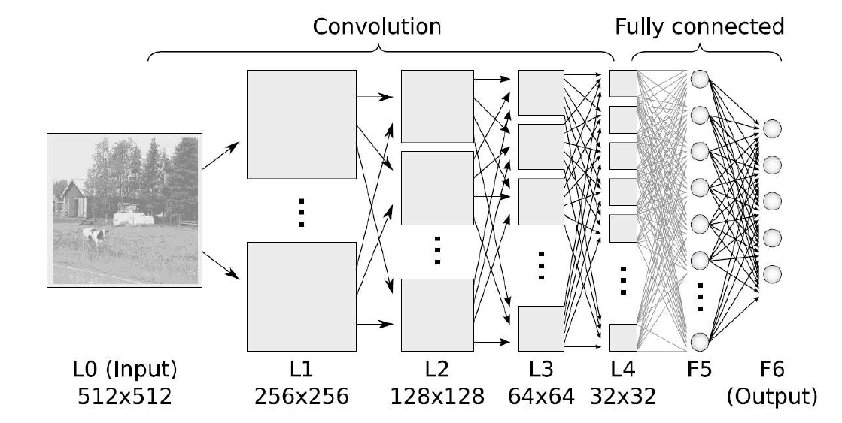
CLASSIFICATION
Vanilla Convolutional Neural Networks

Slide 27
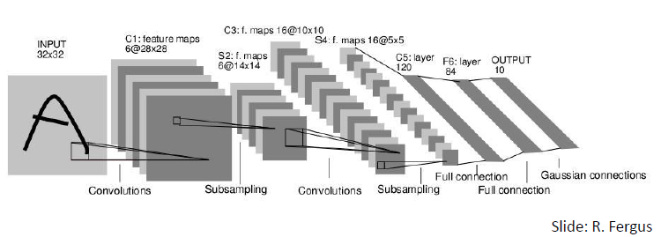
LENET 🡪 VANILLA META ARCH
Notes:
Yann LeCunn
Features map = Multiple different features extractors
This trick of having multiple copies of the same neuron is roughly analogous to the abstraction of functions in mathematics and computer science. When programming, we write a function once and use it in many places – not writing the same code a hundred times in different places makes it faster to program, and results in fewer bugs. Similarly, a convolutional neural network can learn a neuron once and use it in many places, making it easier to learn the model and reducing error.
- Eye is made of receptive fields = ConvFilters
- Learn local features
Zoom out because local features are almost the same, we are interested in the big picture = MaxPooling
Then we need to learn global features = Fully connected
Then we want a classification model out = Softmax

Slide 28
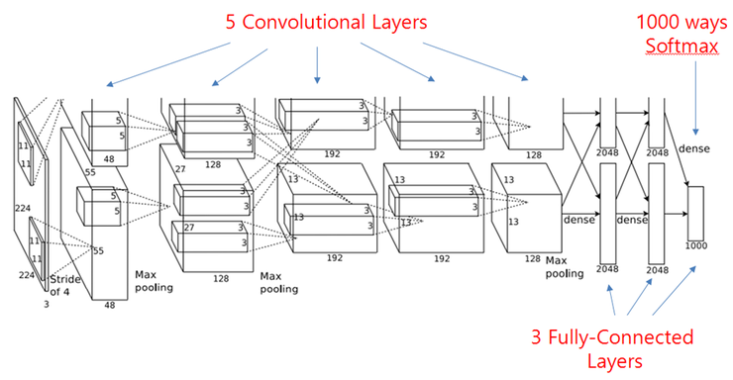
ALEXNET (2012) 🡪 VANILLA META ARCH

Slide 29
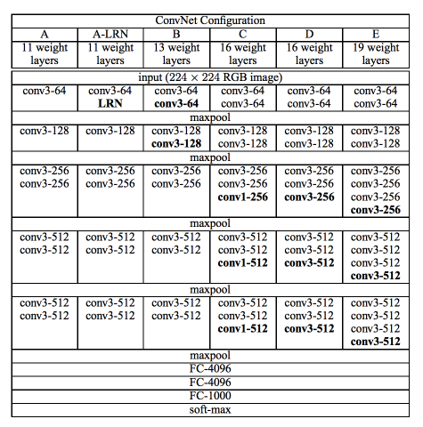
VGG16 AND 19 (APR 2015) 🡪 VANILLA META ARCH
Very Deep Convolutional Networks for Large Scale Image Recognition.
16-19 layers
Unfortunately, there are two major drawbacks with VGGNet:
1- It is painfully slow to train. (pre-train small and initialize larger)
2- The network architecture weights themselves are quite large (in terms of disk/bandwidth).
Due to its depth and number of fully-connected nodes, VGG is over 533MB for VGG16 and 574MB for VGG19. This makes deploying VGG a tiresome task.

Slide 30
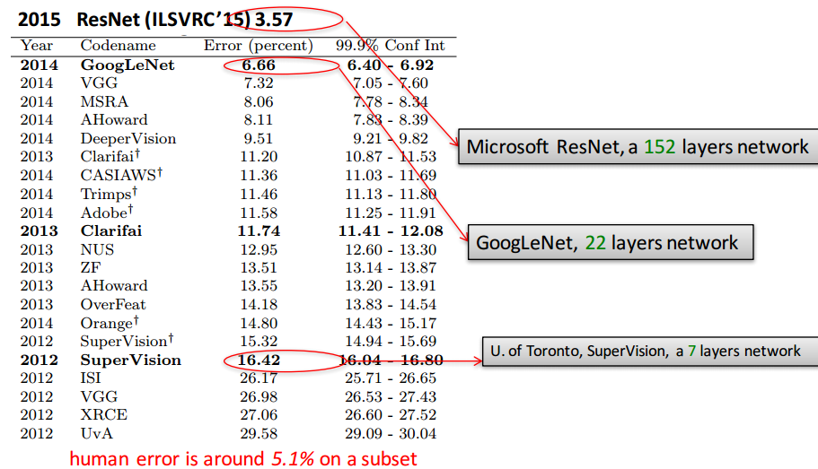
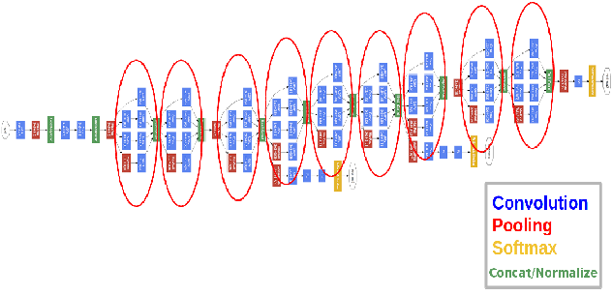
GOOGLENET (2014) 🡪 INCEPTION META ARCH
Winning architecture on ImageNet 2014
Based on inception idea

Slide 31
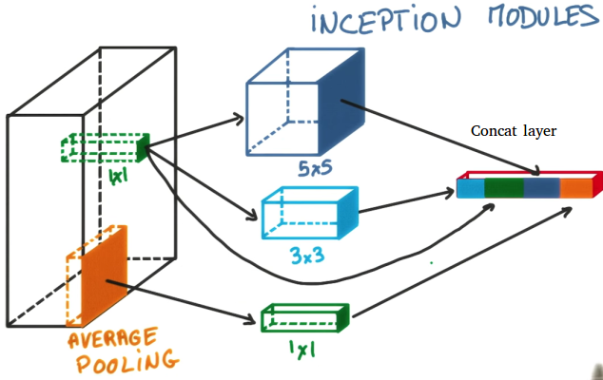
INCEPTION
The idea of the inception layer is to cover a bigger area, but also keep a fine resolution for small information on the images.
So the idea is to convolve in parallel different sizes from the most accurate detailing (1x1) to a bigger one (5x5).
The idea is that a series with different sizes, will handle better multiple objects scales. With the advantage that all filters on the inception layer are learnable.

Slide 32
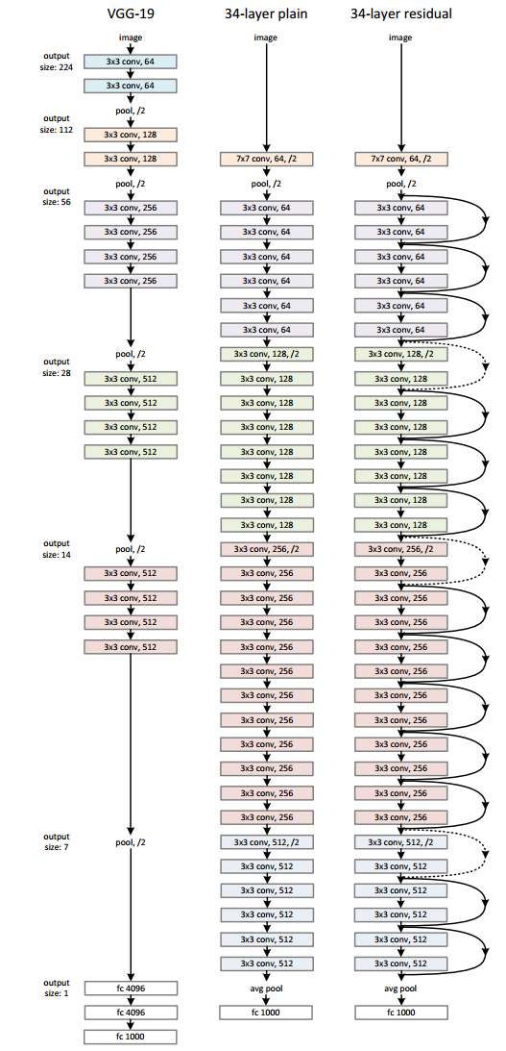
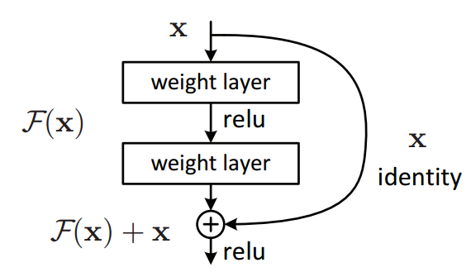
MS RESNET (2015) 🡪 SKIP CONN META ARCH
Relies on the concept of Network-In-Network (NIN) architecture
The ResidualNet it's basically a 150 deep convolution neural network made by equal "residual" blocks. 1000+ layer conv net for the CIFAR-10.
Very deep networks 🡪 vanishing gradients
Remember that the back-propagation of a sum node will replicate the input gradient with no degradation.
Again like googlenet we must use bottlenecks to avoid a parameter explosion.
So they view the map F(x):=H(x)−x as some residual map.
They use a skip layer connection to cast this mapping into F(x)+x=H(x).
So if the residual F(x) is "small", the map H(x) is roughly the identity.

Slide 33
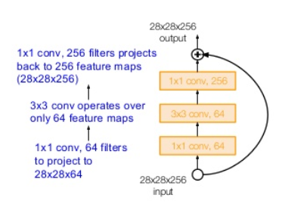
ResNet Bottleneck
As we go deep, we have more filters (out_channels)
This increases conv computations
Bottleneck:
1x1 to reduce channels
Perform conv
Project back: 1x1 to return back to original out_channels

Slide 34
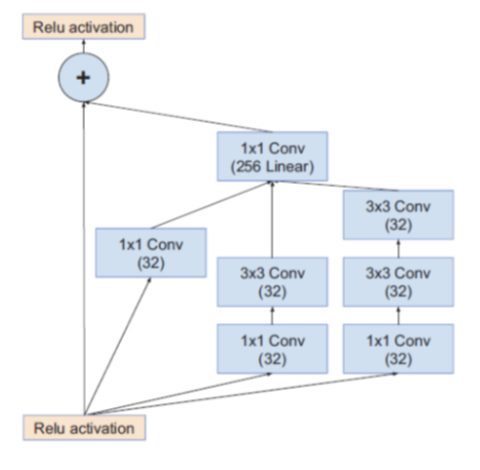
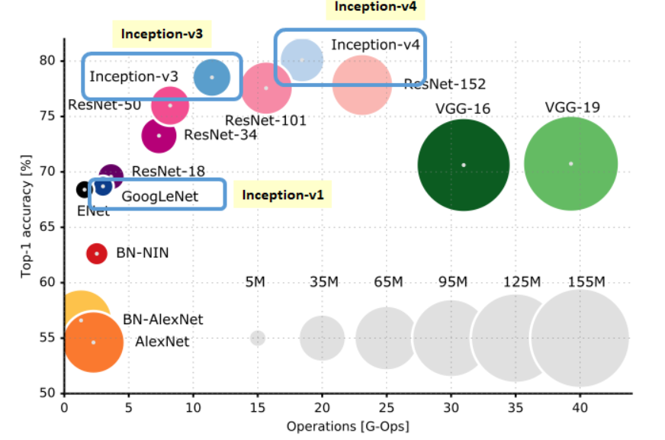
Inception v-4: Inception + SkipConn
Bigger circle means more computations/complexity

Slide 35
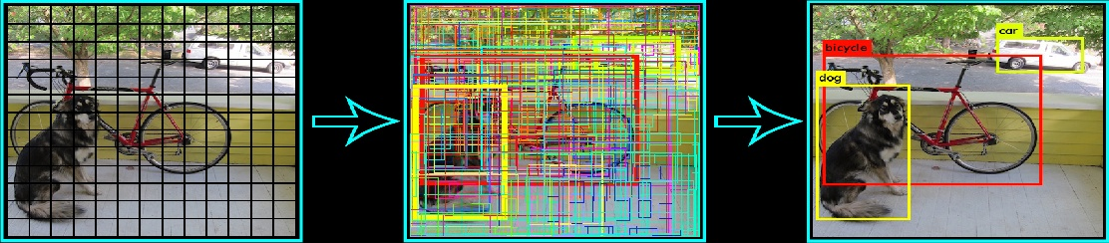
DETECTION
Mix of search and classify problem
Traditional method:
1- Get region proposals 🡪 Better to have prior models (anchors) to handle different sizes/scales
2- Run a classifier on each🡪 Object/No object

Slide 36
DETECTION
Object detection
Deep Learning
Traditional
Region proposals + Classifier
Single shot detectors
DPM
R-CNN
Fast R-CNN
Faster R-CNN
YoLo
SSD
DSSD

Slide 37
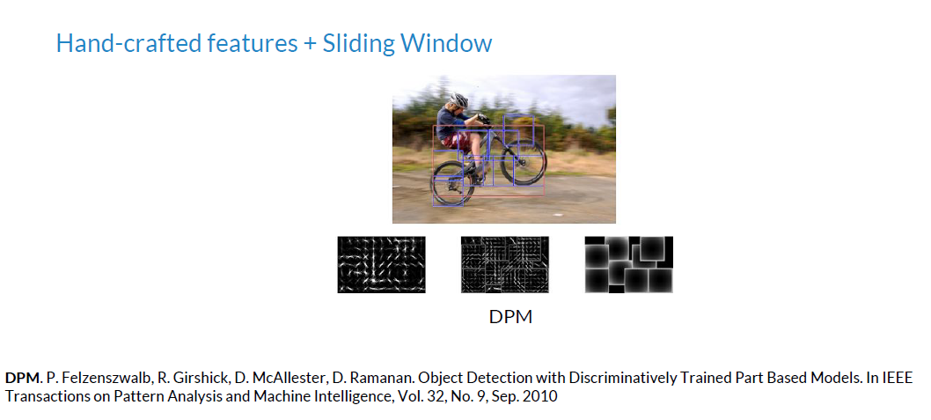
REGION PROPOSALS
Discriminatively trained deformable part models

Slide 38
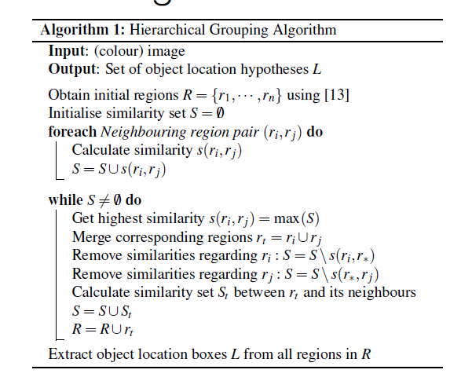
REGION PROPOSALS
Selective Search vs Exhaustive Search (Sliding window):
We can use segmentation:
1- Fast segmentation algorithm based on pairwise region comparison (by Felzenszwalb etal.) -> initial regions •
2- Greedily group regions together by selecting the pair with highest similarity
3- Until the whole image become a single region
4- Generates a hierarchy of bounding boxes

Slide 39
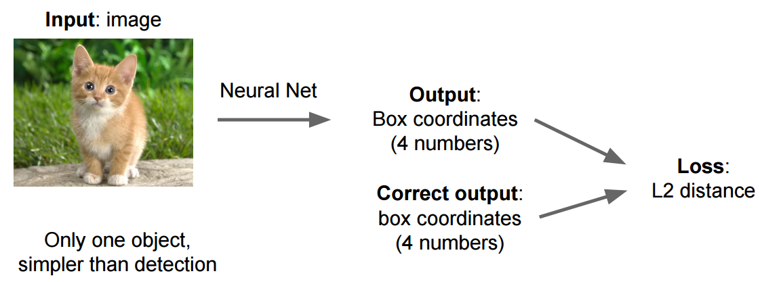
LOCALIZE OBJECTS WITH REGRESSION

Slide 40
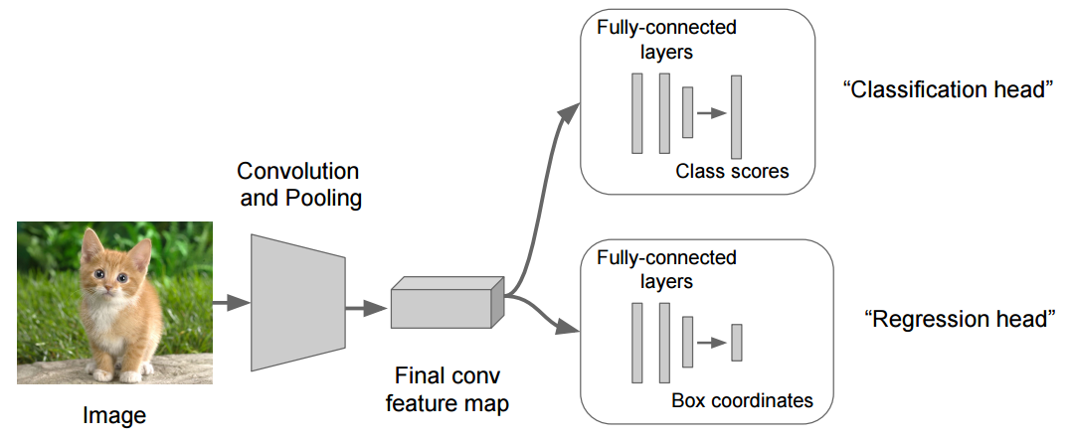
LOCALIZE + CLASSIFY OBJECTS WITH REGRESSION
Pre-trained: e.g. VGG
Using transfer learning, it can be done on classification task

Slide 41
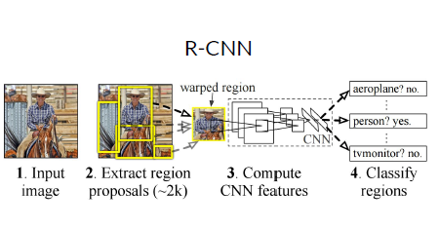
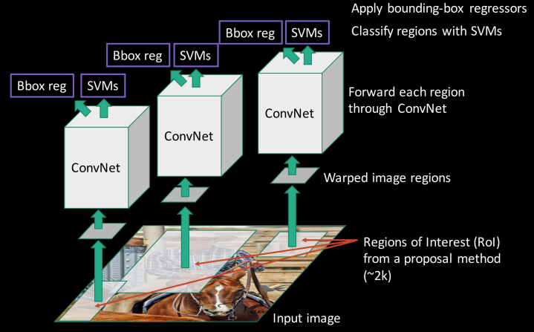
R-CNN

Slide 42
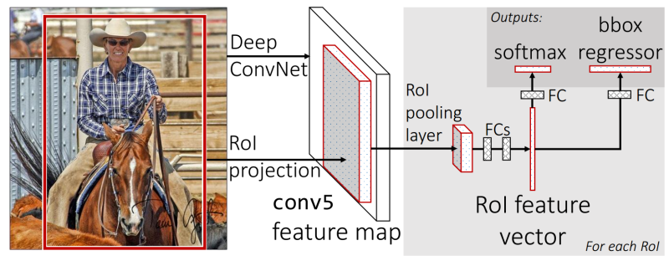
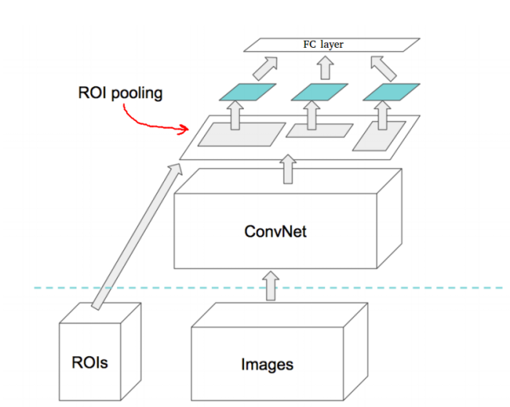
FAST R-CNN
The Fast RCNN method receive region proposals from some external system (Selective search). This proposals will be sent to a layer (Roi Pooling) that will resize all regions with their data to a fixed size. This step is needed because the fully connected layer expect that all the vectors will have same size
No run of the classifier multiple times on different regions
Still using external Region proposal method (slow)

Slide 43
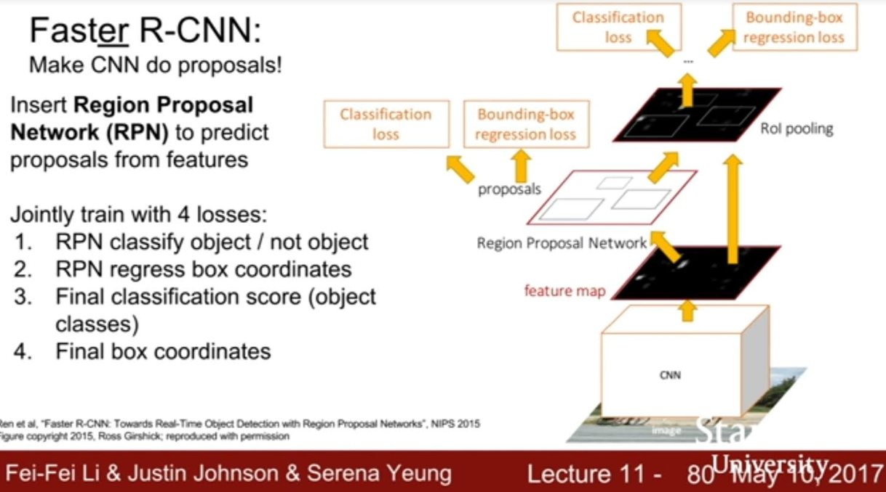
FASTER R-CNN
No external Region proposal method
Two modules in pipeline🡪 repeated computations

Slide 44
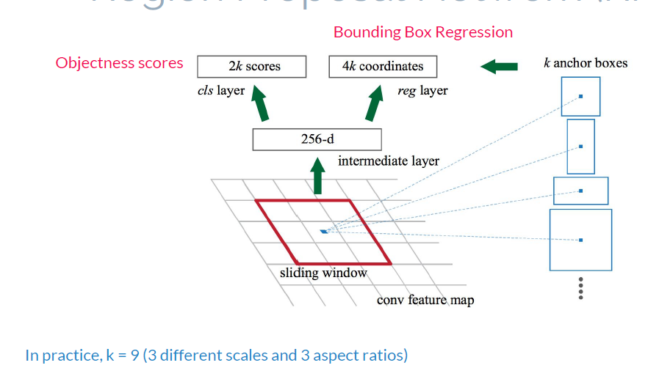
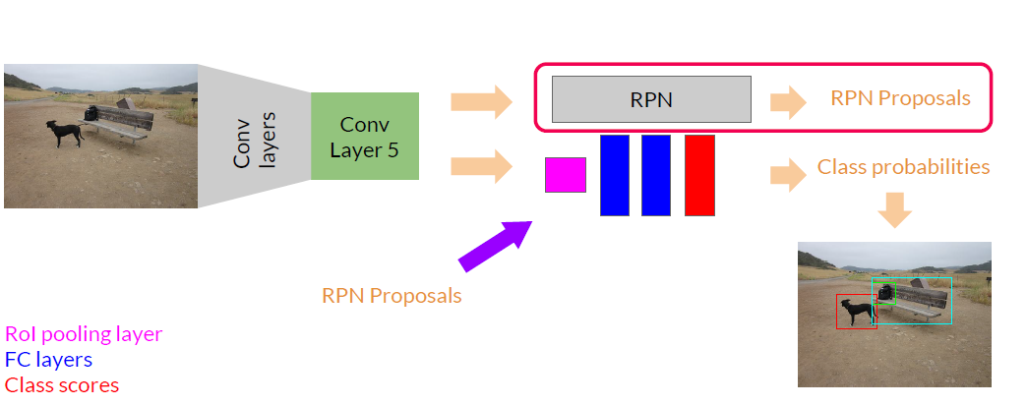
REGION PROPOSAL NETWORK (RPN)
Anchors = (Prior Default models to look for)
Works on pre-trained features extractor (e.g. VGG)

Slide 45
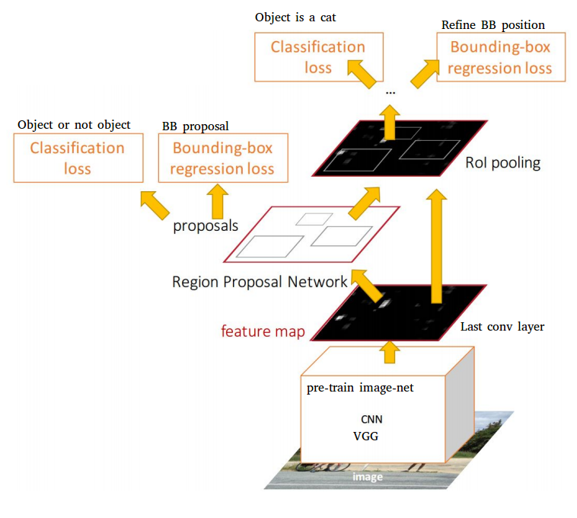
SINGLE SHOT DETECTORS
All previous methods have pipeline of two parts: 1) Regions proposals 2) Classification
Low frame rate, not suitable for embedded devices
Combine both into one network:
One way to reuse the computation that is already made during classification to localize objects is to grab activations from the final conv layers.
Duplicated

Slide 46
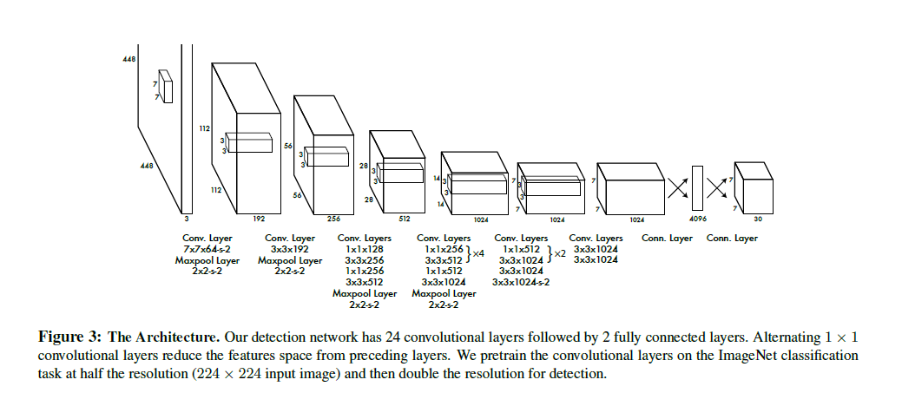
YOLO: YOU ONLY LOOK ONCE

Slide 47
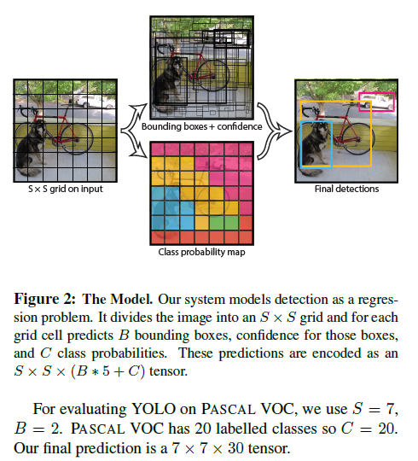
YOLO: YOU ONLY LOOK ONCE
The tiny version is composed with 9 convolution layers with leaky relu activations.
Observe that after maxpool6 the 448x448 input image becomes a 7x7 image.
PASCAL VOC:
S = 7 cells
B = 2 boxes
C = 20 classes

Slide 48
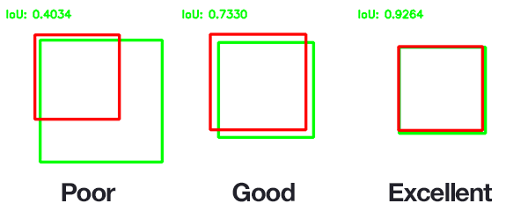
HOW TO GET THE GROUND TRUTH?
Which OBB error to backprop in loss?
Each cell predicts B (=2) boxes which has the center within the cell.
The bounding box loss with highest IOU (Intersect over union) with the ground truth is backpropagated

Slide 49
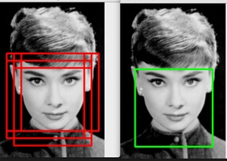
NON MAXIMA SUPPRESSION
Which OBB to take in case of multiple detections?
During prediction (inference) time (after training) you may have lot's of box predictions around a single object.
The NMS algorithm will filter out those boxes that overlap between each other and also some threshold on confidence.

Slide 50
YOLO V2
The Yolo detector has been improved recently, to list their main improvements:
Faster
More Accurate (73.4 mAP(Mean average precision over all classes) on Pascal dataset)
Can detect up to 9000 classes (Before was 20)

Slide 51
YOLO V2 - IMPROVEMENTS
Now they use anchor boxes like Faster-RCNN , the classification is done per-box shape, instead of per each grid-cell 🡪 The predictions are the delta shift of the anchor/default box
Instead of manually choose the box shape, they use K-means to get a box shape based on data
Train the network at multiple scales, as the network is now Fully Convolutional (NO FC layer) this is easy to do.

Slide 52
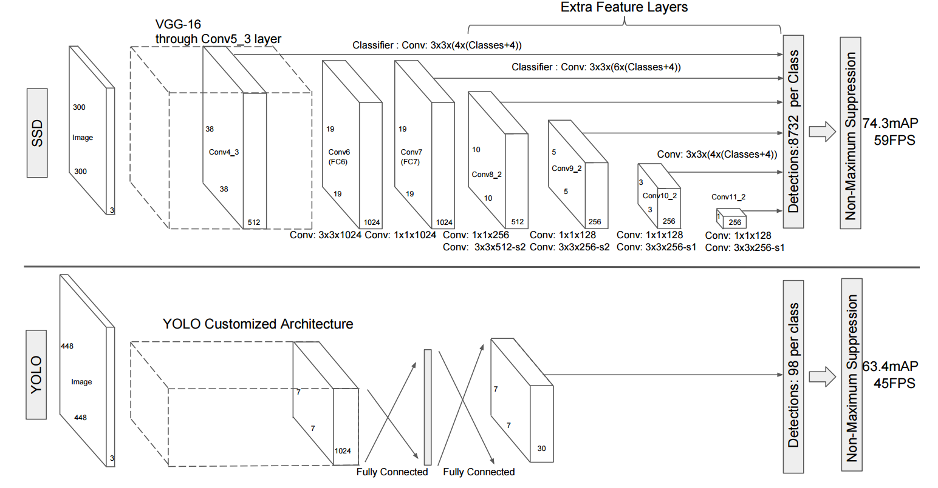
SSD
Detections at different scales
The SSD detector differs from others single shot detectors due to the usage of multiple layers that provide a finer accuracy on objects with different scales. (Each deeper layer will see bigger objects).

Slide 53
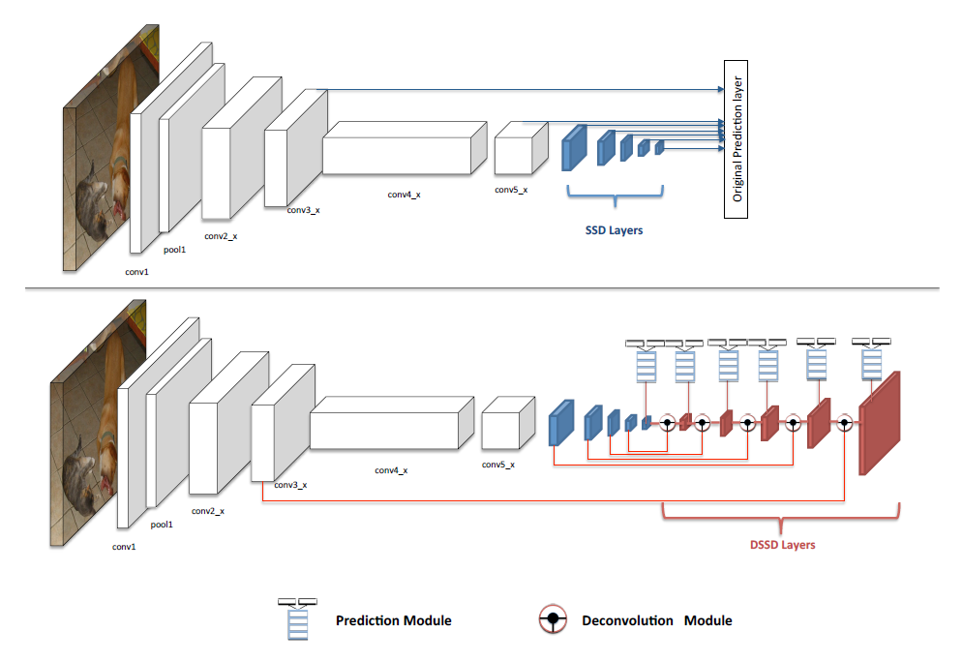
DSSD : DECONVOLUTIONAL SINGLE SHOT DETECTOR
Detections at up scales in image domain
Good to handle small objects or far ones

Slide 54
CLASSIFICATION + DETECTION (PRE-TRAINED SQUEEZENET)

Slide 55


Semantic Segmentation

Slide 56


Super Pixel
Color the super pixels by its class
Lower dimension representation
How to obtain the super pixels?

Slide 57

Conditional Random Fields
Ci = softmax(X_super_pixel)
Super pixel = Simple convolution kernel
Kernels are limited in size
Shallow features

Slide 58

How to define super pixels?
With convolution filters spanning the image, they can be a form of a super pixel.
But this would be a shallow model. No spatial hierarchy.
And also, the super pixels will be small. Not looking at a big part of the image.
A better idea is to use a deep conv model, and use the final feature map (say 7x7 or 4x4) that divide the input into large grids, which are very good super pixels.
Deep Feature Maps are grids on the input → Bigger super pixels

Slide 59


Better super pixels?
Not only that, we can have multiple features per grid (super pixel) thanks to the output feature maps
Each grid/super pixel will have a vector of features (all grids form input feature map)
Each class will have its own probability based on all input features (output feature map)

Slide 60


Fully Convolutional Model

Slide 61

Encoder-Decoder Architecture
We could find a way using deep feature maps to get good super pixels
Now we are left with 2 more operations:
1- Upsampling again to the original image size:done with deconv or bilinear upsampling
2- Class heatmaps:done with 1x1 conv with output feature maps = n_classes

Slide 62

Encoder
How to downsample?
Just the ‘VALID’ conv downsizes the size
But it’s not enough
If we just use the raw image, keep the same size, or just use VALID conv we face two issues:
1- No spatial hierarchy
The division of image into grids is just the pixels!
Since we don't have any zooming out effect, the final feature map will divide the input input a lot of grids (say 20x20). This means that, the upper layers will be focusing on very small parts of the input image, which is not very different than if we used the original image as a feature!
We need the features from the last convolution layer to contain information about the totality of the input.

Slide 63
Encoder
How to downsample?
Just the ‘VALID’ conv downsizes the size
But it’s not enough
If we just use the raw image, keep the same size, or just use VALID conv we face two issues:
2- The final feature map is huge!
We will have more features as we go.
We need to reduce the size of the feature map as we go deeper.
VGG Example:
The final feature map has say 22 × 22 × 64 = 30,976 total coefficients per sample. This is huge. If you were to flatten it to stick a Dense layer of size 512 on top, that layer would have 15.8 million parameters.

Slide 64

Downsampling - How?
Stride 2 conv: Using stride 2 means the width and height of the feature map are downsampled by a factor of 2 (in addition to any changes induced by border effects). So in SAME conv (the most widely used type, we halve the size by stride 2 conv
According to the equations (valid: (N-M+1)/S, normal: (N-M+2P)/S + 1) stride 2 conv gives roughtly half the size:
Stride 2 Conv
Strided convolutions are rarely used in practice, although they can come in handy for some types of models; it’s good to be familiar with the concept.

Slide 65

Downsampling - How?
Max Pooling
Not learnable!
We could do Average Pool as well
It’s conceptually similar to convolution, except that instead of transforming local patches via a learned linear transformation (the convolution kernel), they’re transformed via a hardcoded max tensor operation.

Slide 66
Decoder
How to get back to original image size (mask)?
Max-unpooling
Upsampling
Transposed Conv (Learnable upsampling)

Slide 67

Max-unpooling: Bed of nails

Slide 68

Max-unpooling: Memorize
Early attempts (SegNet): memorized unpooling. Keep track with max you take and spread it back.

Slide 69

Upsampling
Upsample is simply the opposite of max pool. It can spread based on NN pixels, or using bilinear transforms.

Slide 70


Learnable upsampling = Transposed Conv
Not Deconv: in DSP deconv is a different operation
Transposed Convolution
Take every pixel in the input
Multiply it by the filter (3x3)
Apply the resulting 3x3 values (size=kernel size) to the part of the output (3x3 region)

Slide 71

Why this is called Transposed Conv?

Slide 72

Why this is called Transposed Conv?
Sometimes called “Backward strided conv” since the equations of forward trans conv are the same as the backward propagation of gradients for normal conv (take the gradient and spread it back on the input based on the kernel weights)

Slide 73

Why this is called Transposed Conv?
When stride > 1, conv transpose is no longer normal conv

Slide 74


Transposed Conv = Fractionally strided conv
Stride = ratio(movement in output/movement in input)
Stride 2 conv: The kernel moves 2 steps over the input to give 1 output pixel. Stride = 2. Output size is ½ input size.
The filter moves 2 pixels in the output for every 1 pixel in input. Stride = 1/2

Slide 75

Upsampling vs. Transposed Conv
What if (N-M+1)/S is a fraction? Unfortunately, transposed conv can easily have “uneven overlap,” putting more of the metaphorical paint in some places than others [7]. In particular, deconvolution has uneven overlap when the kernel size (the output window size) is not divisible by the stride (the spacing between points on the top)
To avoid artifacts:
Upsampling is better than transposed conv
Or
Use proper kernel and strid (no fractions)
Play with kernel and strid here: https://distill.pub/2016/deconv-checkerboard/

Slide 76

Decoder
Upsample + Conv → UNet
Another approach is to separate out upsampling to a higher resolution from convolution to compute features. For example, you might resize the image (using nearest-neighbor interpolation or bilinear interpolation) and then do a convolutional layer. This seems like a natural approach, and roughly similar methods have worked well in image super-resolution

Slide 77

How to get the class labels heatmap?
Done with 1x1 conv with output feature maps = n_classes
1x1 conv is a special operation that helps in reducing the number of feature maps, i.e. the depth of the feature maps.
The 1x1 conv works as a per feature map weighted average to produce bigger or small number of input features maps as you want. A 1x1xout_maps shall produce the same input size (LxW) of the input feature maps, but with the required out_maps number, where every input feature map is multiplied by a weight, and the result is the weighted sum of all the input maps, and every out_map has such weights (cube).
Notes:
https://machinelearningmastery.com/introduction-to-1x1-convolutions-to-reduce-the-complexity-of-convolutional-neural-networks/

Slide 78




U-NET (SEGNET + SKIP CONNECTIONS)

Slide 79
SEMANTIC SEGMENTATION WITH SEGNET

Slide 80
Instance segmentation
Instance segmentation = Object detection + semantic segmentation
Can be done by programming (mask SS masks with OBB’s). But pixels within a box don’t all correspond to the same class. OBBs can overlap

Slide 81

Mask R-CNN
Better: train SS + OBB losses jointly
OBB class+coordinates are auxiliary tasks in this case to help the network get the boundaries unlike pure SS with no boundaries
GT must be prepared in this way (hard annotation)

Slide 82
AGENDA
Part 3: 3D Deep Learning for computer vision

Slide 83

3D COMPUTER VISION APPLICATIONS

Slide 84



LIDAR DATA
Point Cloud (PCL)

Slide 85
KITTI VISUALIZATION

Slide 86

COMPUTER VISION PROBLEMS
3D Semantic Segmentation
Add Classification Information to the input scan points
None
Car
Truck
Pedestrian
Vespa
Dog
Bicycle

Slide 87

PROBLEMS
Object Bounded Box for dynamic object tracking
3D OBB is very tricky.
Simple hack is to do it in 2D and estimate the objects heights from their classification. Not 100% certain.

Slide 88
3D DEEP LEARNING – 3DDL
DL has a wide success with 2D images
ConvNets
3D geometric data need special attention
PointClouds 🡪 LiDAR
Meshes
Three main approaches
Voxelization
MultiView
PointNet

Slide 89


VOXELIZATION
PCL is not in a regular format, typically transform such data to regular 3D voxel grids
Natural extension into 3D ConvNets
This data representation transformation introduces quantization artifacts

Slide 90


MULTI VIEW
Suffers same quantization errors as Voxelization
Keep the optimum amount of info needed to recognize a 3D shape with the minimum errors
Uses normal 2D ConvNets with multiple channels

Slide 91


MV3D: TWO VIEWS + IMAGE -- KITTI
Good for 2D recognizable shaes; cars, trucks,..etc
Good for 3D recognizable shapes: pedestrians, underdrivables,..etc

Slide 92


POINTNET
No quantization artifacts
Directly consuming the 3D PCL (x,y,z) list

Slide 93


1. SYMMETRY FUNCTION FOR UNORDERED SET

Slide 94

2. LOCAL AND GLOBAL INFORMATION AGGREGATION
Classification can be done on global features
Segmentation must be done on Point Features
Concatenate both for a Segmentation Network

Slide 95
3. JOINT ALIGNMENT NETWORK
The semantic labeling of a point cloud has to be invariant if the point cloud undergoes certain geometric transformations, such as rigid transformation.
A natural solution is to align all input set to a canonical space before feature extraction.
-Predict an affine transformation matrix by a mini-network and directly apply this transformation to the coordinates of input points.
- The mini-network itself resembles the big network and is composed of basic modules of point independent feature extraction, max pooling and fully connected layers.

Slide 96

POINTNET
Max is a symmetric function🡪 Good for unordered set of PCL points
The T-Nets help resiliency to affine transforms
Local (Point) + Global features concat. Needed for point classification

Slide 97
POINTNET PROS AND CONS
No quantization artifacts
Poor in handling local structures and dynamic scenes
Vanilla PointNet can be though of a fully connected NN
ConvNets kernels were introduced to handle local structure
PointNet ++ to PointNet can be thought of as ConvNets to Fully connected NN

Slide 98


POINTNET++
Set Abstraction Layer
Sampling Layer: defines the local regions to process
Group Layer: collects the points in that local region
PointNet Layer: Apply mini-PointNet to get local region features

Slide 99

DEMO
None
Car
Truck
Pedestrian
Vespa
Dog
Bicycle

Slide 100

MULTI-TASK LEARNING
2D 🡪 MultiNet on KITT

Slide 101

MULTI-TASK LEARNING
3D 🡪 PointNet

Slide 102
REFERENCES
https://www.slideshare.net/xavigiro/faster-rcnn-towards-realtime-object-detection-with-region-proposal-networks?from_action=save
https://leonardoaraujosantos.gitbooks.io/artificial-inteligence/content/
http://www.themtank.org/pdfs/AYearofComputerVisionPDF.pdf
http://3ddl.stanford.edu/

Slide 103

QUESTIONS

Slide 104


